Slide 1

Red Team v. Blue Team Capstone Engagement Project
Laura J. Pratt
November 2021

Slide 2
Table of contents
This document contains the following sections:
Network Topology
Red Team: Security Assessment
Blue Team: Log Analysis and Attack Characterization
Hardening: Proposed Alarms and Mitigation Strategies

Slide 3


Network Topology

Slide 4
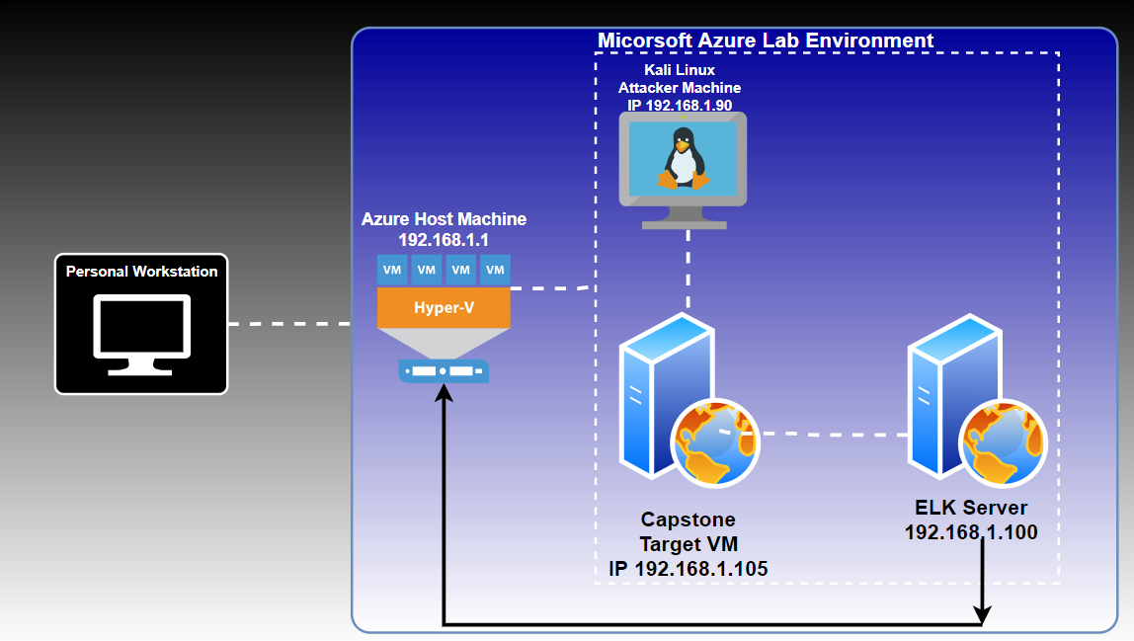
Network topology

Slide 5
Red Team: Security Assessment

Slide 6
Recon: Describing the Target
Nmap identified the following hosts on the network:
Hostname | IP Address | Role on Network
Azure Host Machine | 192.168.1.1 | Host Machine
Kali Linux | 192.168.1.90 | Attacker Machine
Capstone | 192.168.1.105 | Target Machine
ELK Server | 192.168.1.100 | Log Data

Slide 7
Vulnerability Assessment
The assessment uncovered the following critical vulnerabilities in the target:
Vulnerability | Description | Impact
Sensitive Data Exposure (A02:2021 OWASP Top Ten List) | Attackers can use PHP scripts to execute arbitrary shell commands. | Vulnerability allows attackers to open a reverse shell to the servers.
Brute Force Vulnerability | An attack method where login information, passwords and encryption keys are attempted until there is a successful login. | This type of attack can have a significant impact because the attacker can cause loss of data, identity theft, and unauthorized access to confidential data.
Remote Code Injection (A03:2021 OWASP Top Ten List) | Code injection, also called Remote Code Execution (RCE), occurs when an attacker exploits an input validation flaw in software to introduce and execute malicious code. https://www.netsparker.com/blog/web-security/code-injection/ | Malicious code can be injected to possibly gain access to sensitive data and compromise the confidentiality and integrity of the information.

Slide 8
Exploitation: Sensitive Data Exposure
1
Tools & Processes:
-nmap command to determine open ports and IP addresses accepting connections.
-dirb command that is used to find existing and/or hidden web objects, which are the elements of a web page.
-Explore different avenues of the web page.
2
Achievements:
-The secret folder was discovered.
-Folder says for Asthon’s eyes only, leading the direction of the login efforts.
3
Exploitation:
-Finding the open ports and hidden web objects available for accessibility, to include the secret folder that contains further sensitive information.

Slide 9
Exploitation: Brute Force Vulnerability
1
Tools & Processes:
-gunzip rockyou.gz file to unzip the file to be used later in the password cracking step.
-run command with hydra with the username Ashton, which is built within the Kali Linux OS as a login cracker, against the rockyou.txt.
2
Achievements:
3
Aftermath:
-Crack hash and proceed with brute force attack, logging into the web browser, then receiving further instruction on how to connect to the webdav server, which is used in the remote code injection
-brute force attack gaining access to log into the browser to gain access to Ryan’s hashed password, which later leads to access to the webdav browser.

Slide 10
Exploitation: Remote Code Injection
1
Tools & Processes
2
Achievements
-Deploring the remote code injection allows up to open the Meterpreter shell into the target.
-Once this shell is opened, this opens the door to access the full database.
3
Aftermath
-Having access to the full database, provided the opportunity to find the flag, demonstrating the ability to access sensitive data.
-Use Meterpreter to connect to uploaded web shell
-Use shell to explore and compromise target.

Slide 11

Blue Team:
LOG ANALYSIS
AND
ATTACK CHARACTERIZATION

Slide 12
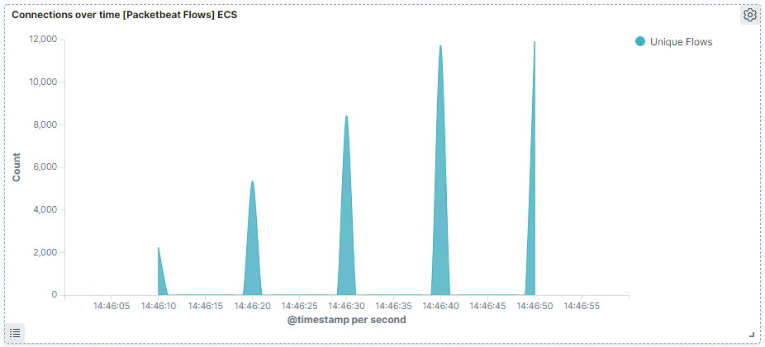
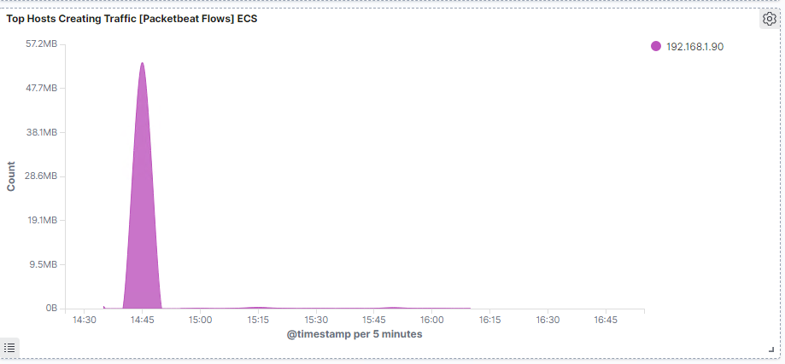
ANALYSIS: IDENTIFYING THE PORT SCAN
What time did the port scan occur?
-2:46 PM
Which IP address is creating the most
traffic?
-192.168.1.90

Slide 13
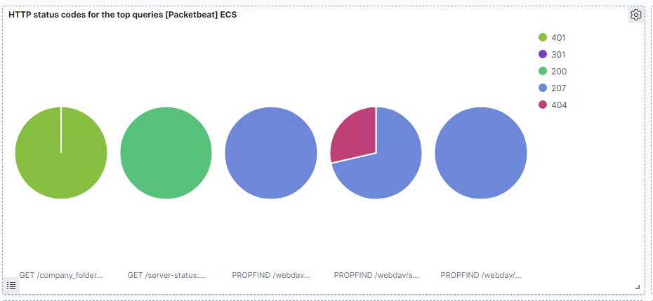
ANALYSIS: IDENTIFYING THE PORT SCAN (cont.)
Response codes by the victim: 401, 301, 200, 207, 404

Slide 14
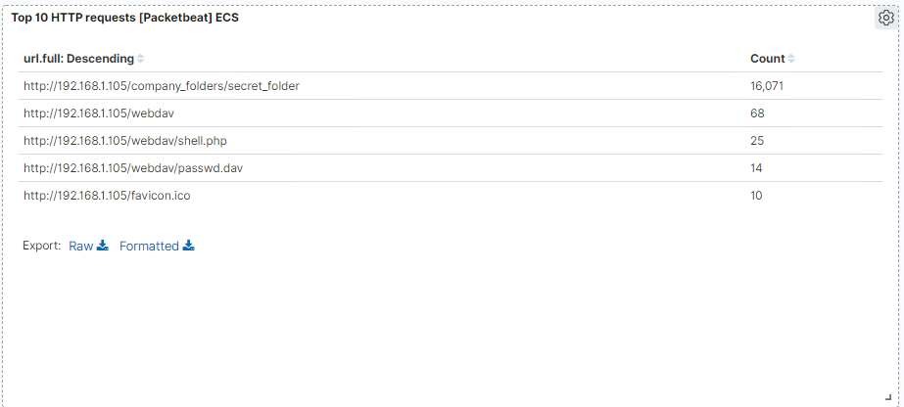
Analysis: finding the request for the hidden directory
The request occurred at 2:46 PM
Top 3 Files Requested:
/company_folders/secret_folder (16,071)
/webdav (68)
/webdav/shell.php (25)

Slide 15
Analysis: finding the webdav connection
This demonstrates the secret folder, webdav and the shell.php
were requested numerous times.

Slide 16
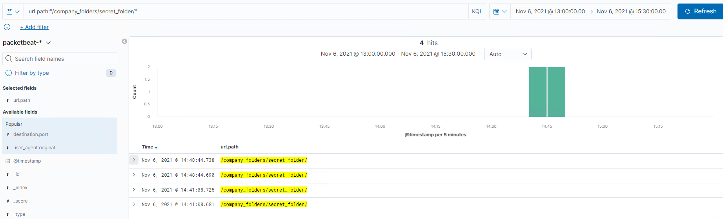
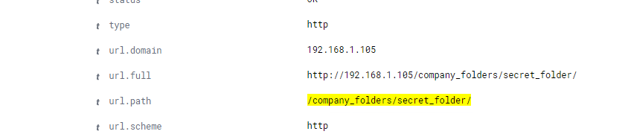
Analysis: Uncovering the brute force attack
By searching in the URL path
to the successful access to the
/company_folders/secret_folders/,
it pulls the results directly that out
of the 16,071 requests, only 4 were
successful.
The logs contain evidence of a large number of requests for the sensitive data. This is a telltale signature of a brute-force attack.

Slide 17
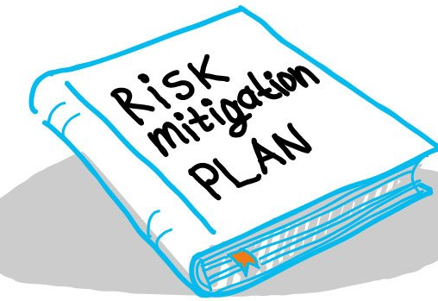

Blue team: Proposed alarms and mitigation strategies

Slide 18
Mitigation: blocking the port scan
Alarm
System Hardening
What kind of alarm can be set to detect future port scans?
- Set a threshold for the # of requests per second.
What threshold would you set to activate this alarm?
-Alarms would be triggered if a given IP address send more than 10 requests per second for more than 5 seconds.
What configurations can be set on the host to mitigate port scans?
-The local firewall can be used to throttle incoming connections
-ICMP traffic can be filtered
-An IP allowed list can be enabled
-Regularly run port scans to detect and audit any open ports

Slide 19
Mitigation: finding the request for the hidden directory
Alarm
System Hardening
What kind of alarm can be set to detect future unauthorized access?
-Allow authorized IP addresses
-Trip alarm if an IP not on the allow list attempts to connect
What threshold would you set to activate this alarm?
-This is a binary alarm: If the incoming IP is not allowed, it fires. Otherwise, it does not.
What configuration can be set on the
host to block unwanted access?
-Access to the sensitive file can be
locally restricted to a specific user.
-This way, someone who gets a shell
as, e.g., www-data will not be able to
read it.
-In addition, the file should be
encrypted at rest.

Slide 20
mitigation: preventing brute force attacks
Alarm
System Hardening
What kind of alarm can be set to detect future brute force attacks?
-# of Requests per Second
What threshold would you set to activate this alarm?
-More than 100 requests per second for 5 seconds should trigger the alarm.
What configuration can be set on the
host to block file uploads?
-Configuring fail2ban or a similar
utility would mitigate brute force
attacks.
- Create a policy that locks out
accounts after 10 failed attempts
- Create a policy that increases
password complexity requirements
- Enable MFA

Slide 21
Mitigation: detecting the webdav connection
Alarm
System Hardening
What kind of alarm can be set to detect future access to this directory?
-Monitor access to webdav with Filebeat
-Fire an alarm on any read performed on files within webdav.
What threshold would you set to activate this alarm?
-Simply fire the alarm whenever someone accesses the webdav directory
-Ideally, allow valid IP addresses.
What configuration can be set on the host
to control access?
-Administrators must install and
configure Filebeat on the host.

Slide 22
Mitigation: identifying reverse shell uploads
Alarm
System Hardening
What kind of alarm can be set to detect future file uploads?
-Alarms should fire upon receipt of any POST request containing form or file data of a disallowed file type, e.g., .php.
What threshold would you set to activate this alarm?
-The alarm should fire whenever users upload a forbidden file.
What configuration can be set on the host
to block file uploads?
-Write permissions can be restricted
on the host.
-Uploads can be isolated into a dedicated
storage partition.
-Filebeat should be enabled and
configured.

Slide 23

That’s all Folks

